Slide 1

Using Big Data Analytics to Model Air Traffic Delays
TECH TEAM @
STEP-UP-TO-STEM JUNE, 2016

Slide 2

TEAM 1 | TEAM 2
MATT MANGANEL | JANET BERRY
WENDY GONG | JAMES PAK
JONATHAN JACKSON | GEORGE BUIUC
JAVIER FLORES | JINWOO SEOL
KEVIN OWUSU | JASON NIETO
VINCENT COBBLAH | ARMANI WILLIS

Slide 3

Using Big Data Analytics to Model Air Traffic Delays
AGENDA
Team introductions
What is Big Data?
Group presentations
Conclusions
Q&A

Slide 4
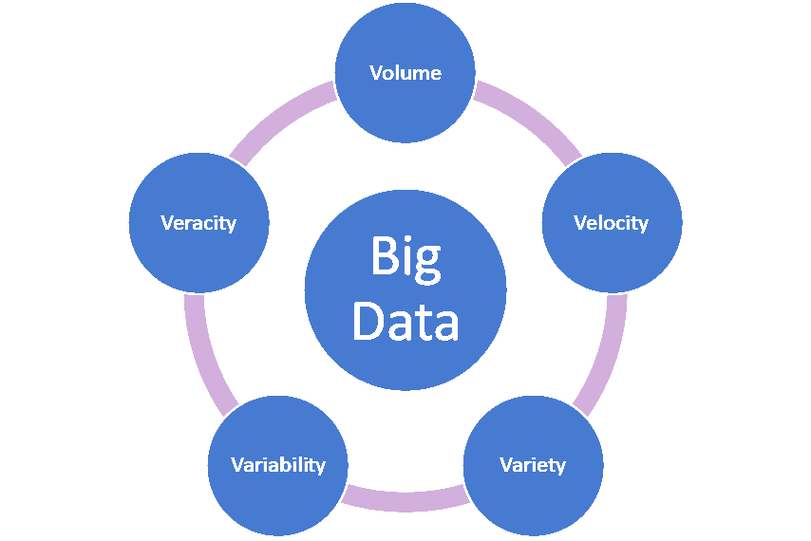
WHAT IS BIG DATA?
Dictionary definition: Big data is extremely large data sets that can be analyzed computationally to reveal patterns, trends, and associations, especially relating to human behavior and interactions.

Slide 5


Slide 6








WHAT IS BIG DATA USED FOR?
Marketing / Elections: Sourcing data from social media (Twitter, Facebook, etc.) and the internet people / companies can target specific markets and make decisions on resource allocation
Research: Hadron collider, OTPS (one-time password specification) movement
Finance : Stock markets
Cyber Security: Passwords
Transportation

Slide 7


RAW DATA: SOURCE & DESCRIPTION
Our group project focused on domestic flight data from RITA (Research and Innovative Technology Administration) which operates under the US Department of Transportation.
Our original data consists of flight arrival and departure details (29 variables) for all commercial flights within the USA from October 1987 to March 2016.
Almost 120 million records in total: 1.6 GB compressed space and 12 GB when uncompressed.
Notes:
Data differs from Group 1: Our data set has less variables because our data is already grouped by airport so certain variables with respect to individual flights (i.e. tail number) are not necessary for our data. Because of the grouping, that our data is able to incorporate more data points cover a longer time period.
For counts: when multiple causes are assigned to one delayed flight, each cause is prorated based on delayed minutes it is responsible for.

Slide 8
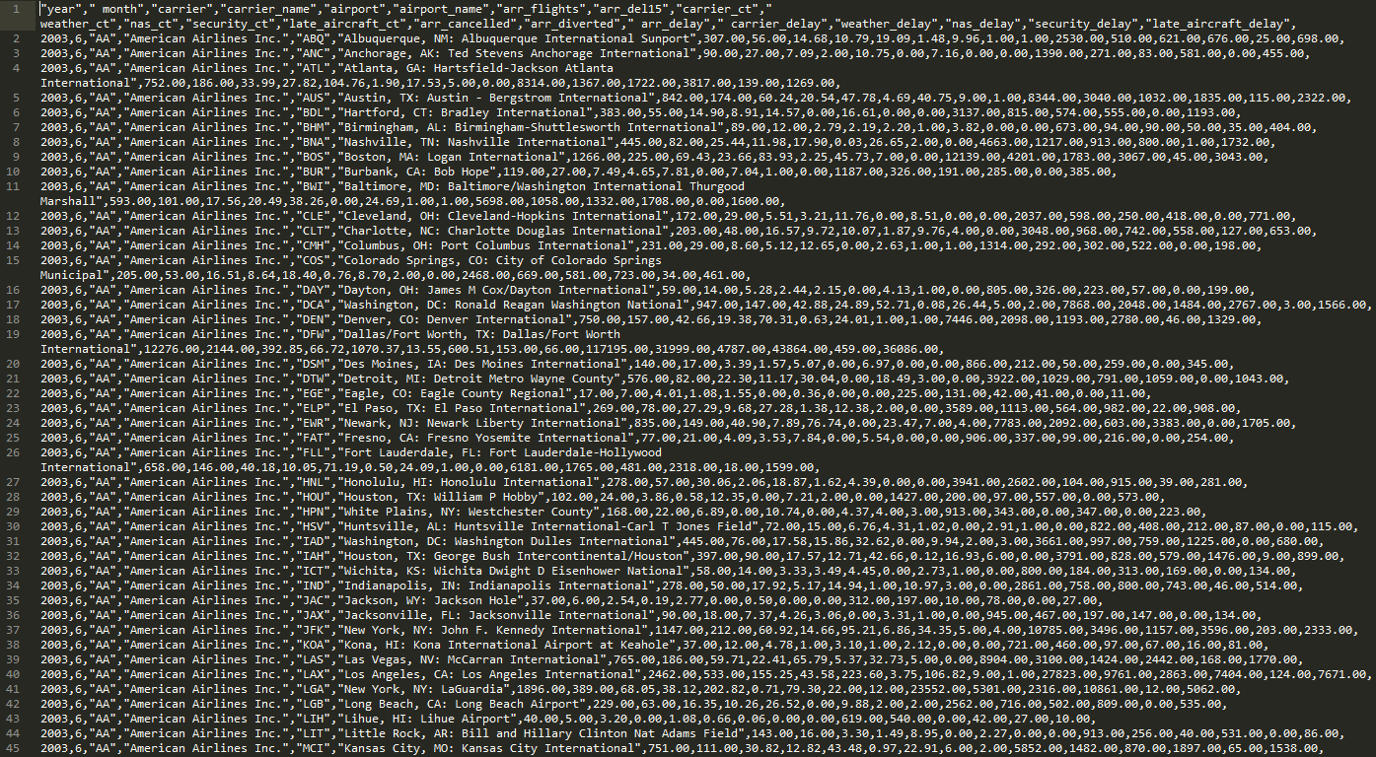
36 KB of data

Slide 9
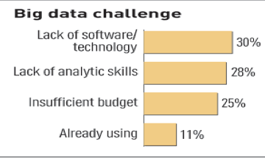
CHALLENGES OF BIG DATA
Limitations in Big Data research:
Data volume, variety, velocity keep increasing
Software / Technology limitations
Skilled data scientists needed

Slide 10



Tools Used for Analyzing Data
MS Excel
Sublime 3

Slide 11

Longitudinal survey of flight delays
and length of delay:
The US Department of Transportation’s(DOT) Bureau of Transportation Statistics(BTS) tracks the on-time performance of domestic flights operated by large air carriers.
Our raw data was sourced from June 2003 to March 2016.
210,901 observations of 22 variables
Variables:
count of delayed flights, broken out by cause
number of minutes delay, broken out by cause

Slide 12
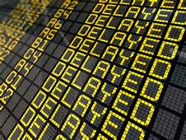
CAUSES OF FLIGHT DELAY
Flight is considered delayed when it arrives 15 or more minutes than the schedule.
NTSB(National Transportation Safety Board) defines flight delays in the context of delays in flight arrival. Causes of flight arrival delays are categorized as follows:
Air Carrier Delay
Aircraft Arriving Late
Security Delay
National Aviation System (NAS) Delay
Extreme Weather
Notes:
Air Carrier: The cause of the cancellation or delay was due to circumstances within the airline's control (e.g. maintenance or crew problems, aircraft cleaning, baggage loading, fueling, etc.).
Extreme Weather: Significant meteorological conditions (actual or forecasted) that, in the judgment of the carrier, delays or prevents the operation of a flight such as tornado, blizzard or hurricane.
National Aviation System (NAS): Delays and cancellations attributable to the national aviation system that refer to a broad set of conditions, such as non-extreme weather conditions, airport operations, heavy traffic volume, and air traffic control.
Late-arriving aircraft: A previous flight with same aircraft arrived late, causing the present flight to depart late.
Security: Delays or cancellations caused by evacuation of a terminal or concourse, re-boarding of aircraft because of security breach, inoperative screening equipment and/or long lines in excess of 29 minutes at screening areas.
http://www.rita.dot.gov/bts/help/aviation/html/understanding.html#q4

Slide 13
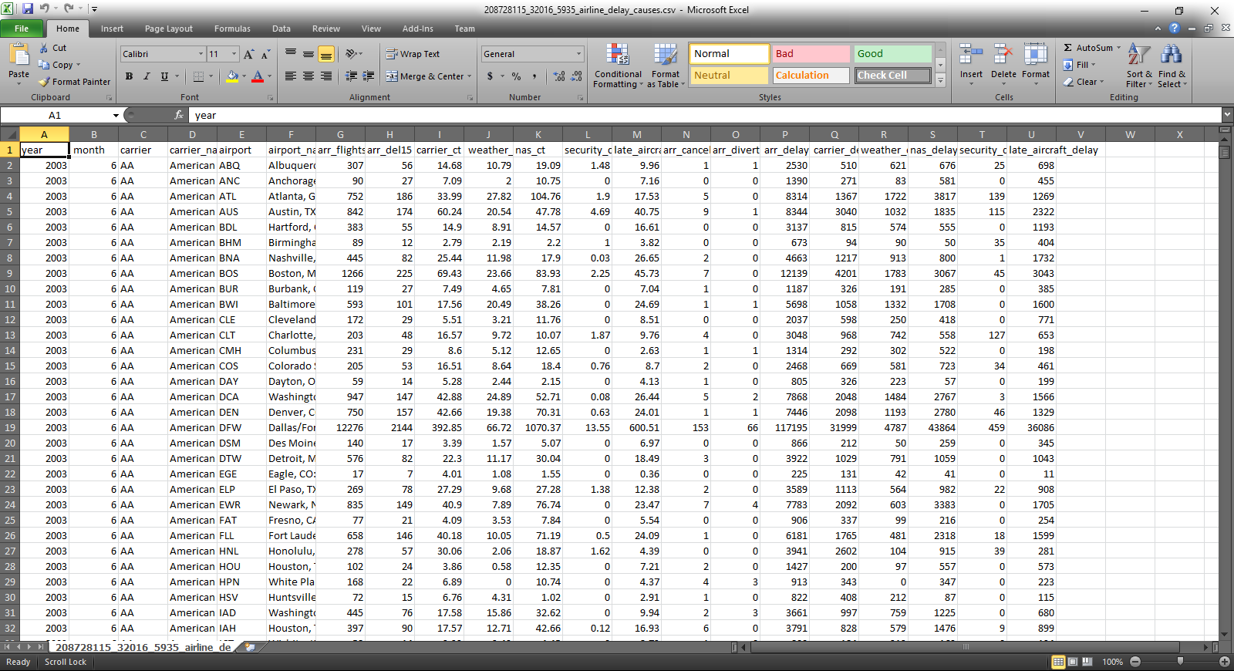
Raw Data in Excel

Slide 14
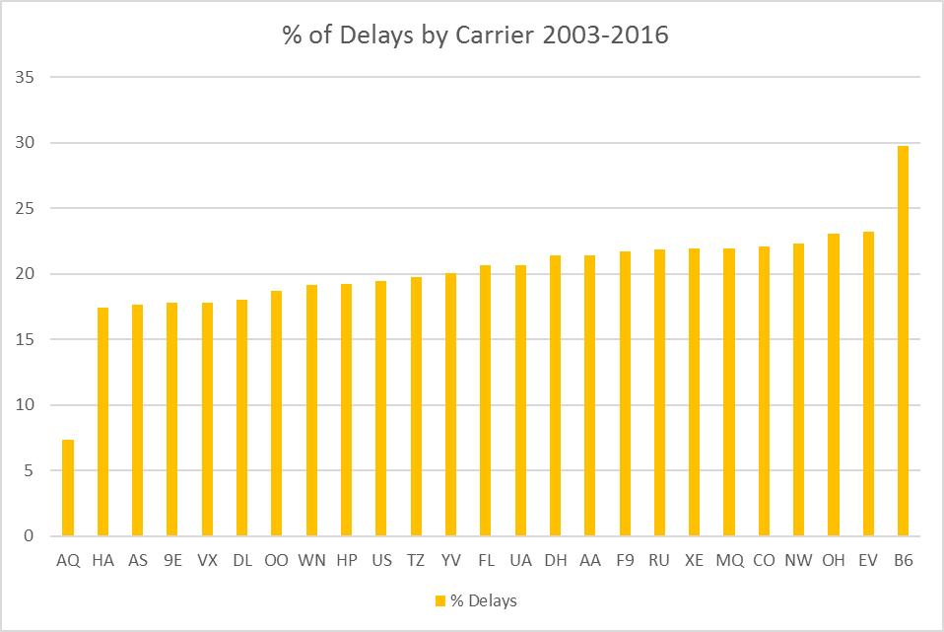
WHICH AIRLINE HAS THE MOST DELAYS ON AVERAGE 2003-2016?
Min. : 7.118
1st Qu. : 18.160
Median : 20.340
Mean : 19.660
3rd Qu. : 21.900
Max. : 29.740
Notes:
R: final
Calculated % of Delay = arr_del15 / arr_flights
Grouped by Airline

Slide 15
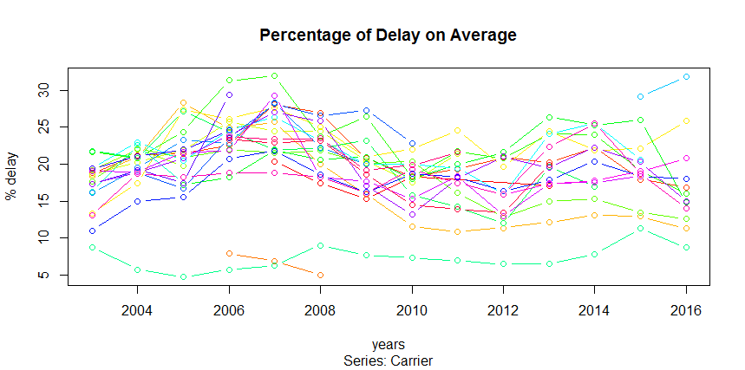
WHAT IS THE PERCENT OF DELAY ON AVERAGE OVER TIME (2003-2016)?
Notes:
R: percent_delay_byyear

Slide 16
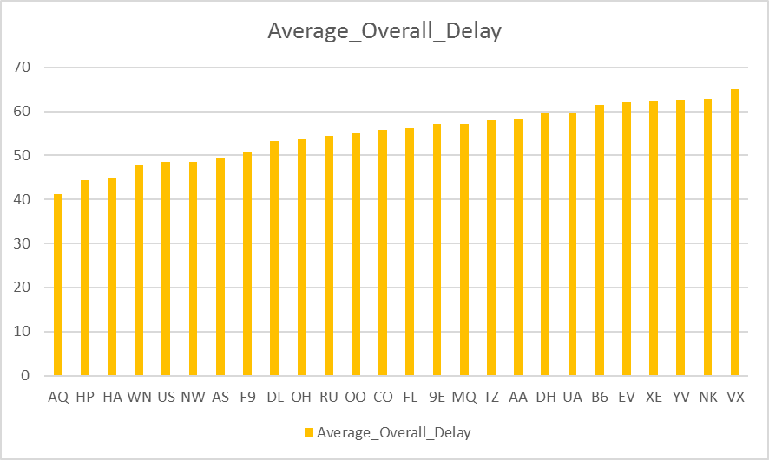
HOW LONG IS THE AVERAGE DELAY BY AIRLINE?
Min
Notes:
Average Delay in minutes of each airline overall (2003-2016) by carrier
Note: slide 1 -- average count of delay has outliers, while average delay time is relatively smooth.
We think how long the total delays can be more important for economic reasons because every delay minutes are cost.
so we divide the total min of delays of each airline by total numb of delay of each airline during a period from June 2003 to Mar 2016 that we can see the average min of delay by airline.

Slide 17
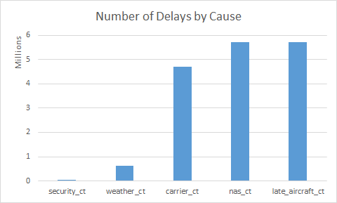
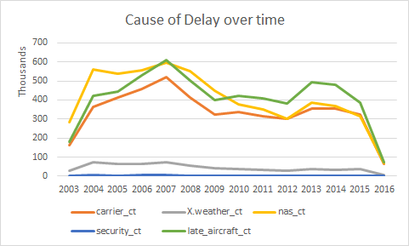
HAVE THE CAUSES OF DELAY CHANGED OVER TIME?
Notes:
Excel: Sheet2
Total count of delay cause 2003-2016

Slide 18
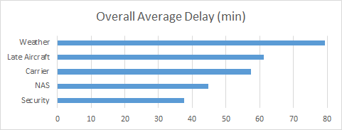
WHICH CAUSE OF DELAY RESULTS IN LONGER DELAY TIME?
Look at individual causes and relation to minutes of delay. Delay time is more costly for an airline. Number of delays may not equal more delays in minutes.
Is there a correlation between the cause of delay and number minutes delayed?
i.e. If there is a weather delay, how many minutes would the aircraft be delayed?
Notes:
Xcel: Databyyear

Slide 19
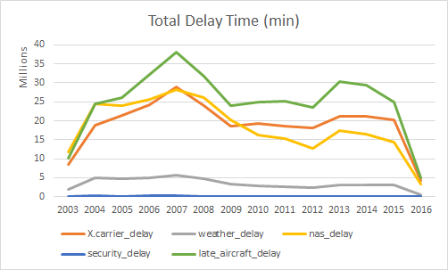
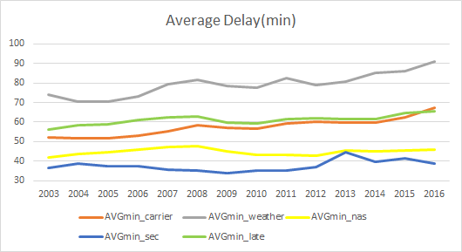
How have the causes of delay changed over time?
Min
Year
Year
variability
stable
Airline efficiency has increased between 2007 and 2010?

Slide 20
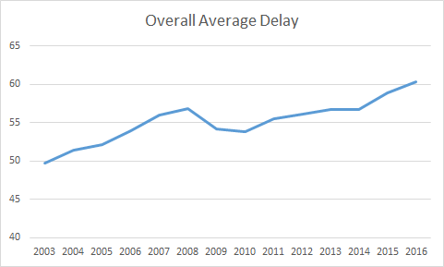
HOW HAS LENGTH OF DELAY CHANGED OVER TIME?
Notes:
Excel: Databyyear

Slide 21
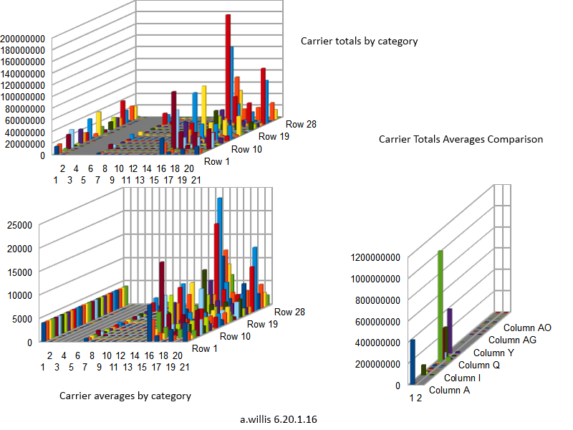
Carrier Graph by Category

Slide 22

RAW DATA: SOURCE & DESCRIPTION
Taken from the Bureau of Transportation Statistics, under RITA(Research and Innovate Technology Administration), a unit of the USDOT
Data consists of flight arrival and departure details for all commercial flights within the USA, in 2008
29 variables
Over 7 million observations, 673 MB
Only 1 million observations used
http://stat-computing.org/dataexpo/2009/the-data.html

Slide 23
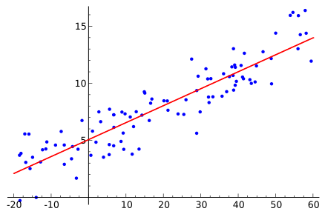
Analysis Tools, Graphs and Models
Sublime 3
MS Excel
Regression Analysis

Slide 24

Cleaning the Data
Removing NAs
Adding binary variables
Delayed on arrival
Delayed on departure

Slide 25
Research Question
What factors impact the amount of delay for an airport?
Total weather delay for each airport
Total arrival delay for each airport
Average arrival delay per flight for each airport

Slide 26
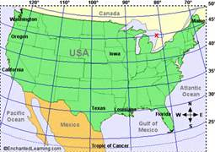
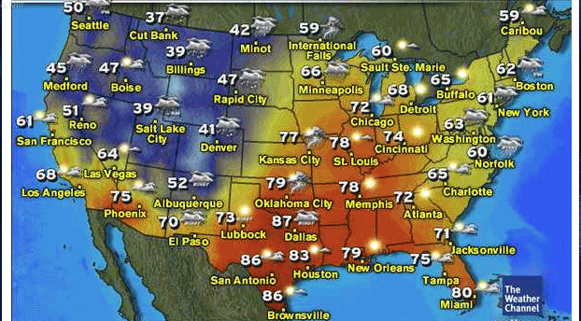
Total Weather Delay For Each Airport
Does the latitude of an airport impact the total amount of delay due to weather?

Slide 27
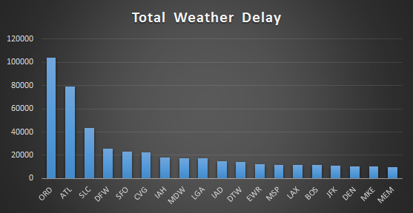
Top 20 Airports
Minutes

Slide 28
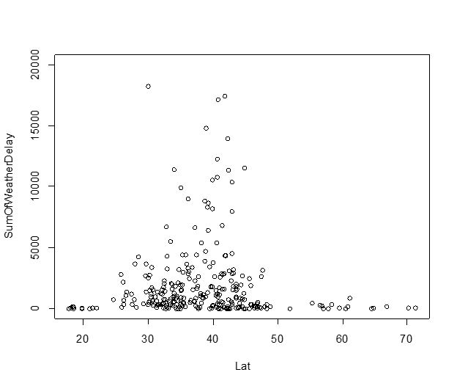
Latitude Vs. Total Weather Delay
Residuals:
Min 1Q Median 3Q Max
-3106 -2690 -2082 -440 100967
Coefficients:
Estimate Std. Error t value Pr(>|t|)
(Intercept) 3262.829 2410.796 1.353 0.177
Lat -8.869 61.411 -0.144 0.885
Residual standard error: 8750 on 285 degrees of freedom
Multiple R-squared: 7.318e-05, Adjusted R-squared: -0.003435
F-statistic: 0.02086 on 1 and 285 DF, p-value: 0.8853
Notes:
need to adjust sizes and fix layout of text and image

Slide 29
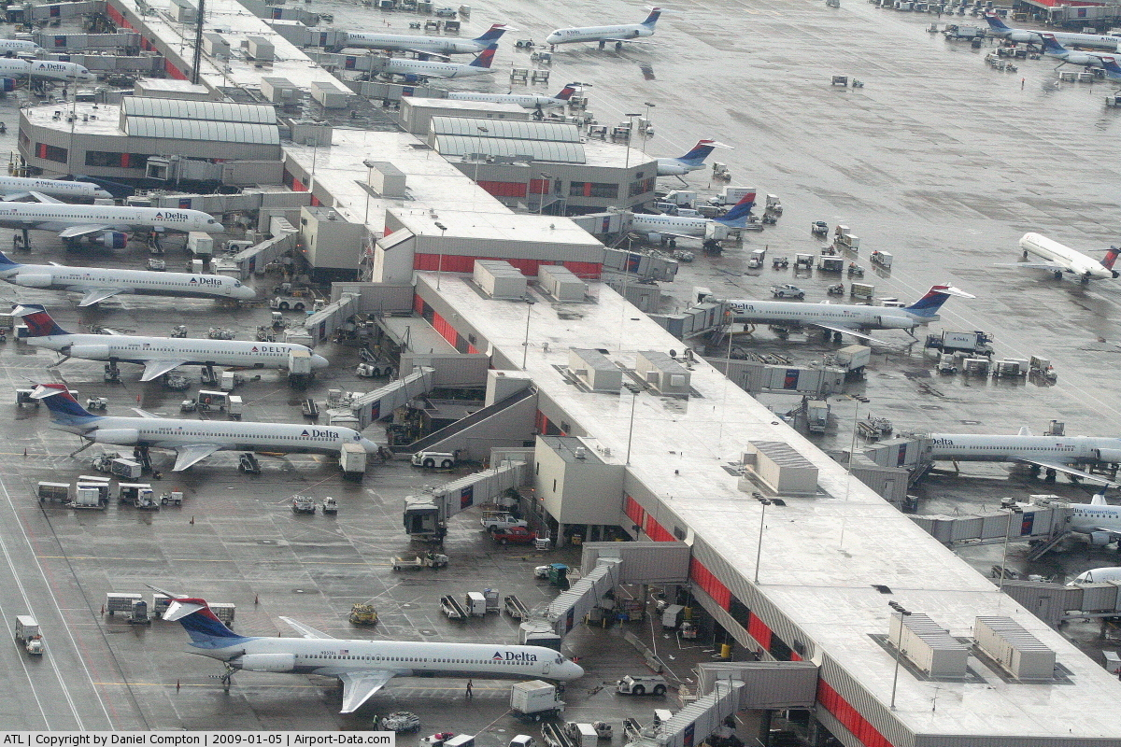
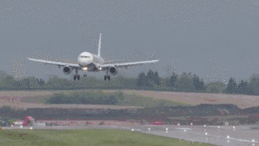
Total Arrival Delay For Each Airport
Does the number of incoming arrivals impact the total arrival delay for a given airport?

Slide 30
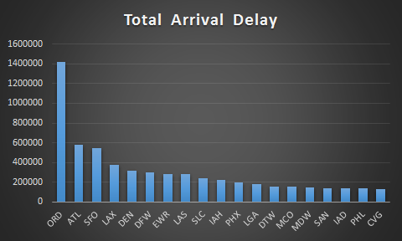
Top 19 Airports
Minutes

Slide 31
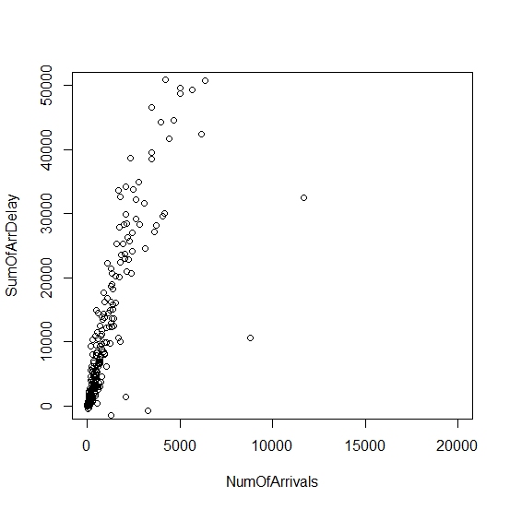
Number of Arrivals Vs. Total Arrival Delay
Residuals:
Min 1Q Median 3Q Max
-207941 647 4859 6193 784058
Coefficients:
Estimate Std. Error t value Pr(>|t|)
(Intercept) -5991.7932 3729.0466 -1.607 0.109
NumOfArrivals 12.5519 0.4636 27.075 <2e-16 ***
Signif. codes: 0 ‘***’ 0.001 ‘**’ 0.01 ‘*’ 0.05 ‘.’ 0.1 ‘ ’ 1
Residual standard error: 56940 on 285 degrees of freedom
Multiple R-squared: 0.7201, Adjusted R-squared: 0.7191
F-statistic: 733.1 on 1 and 285 DF, p-value: < 2.2e-16

Slide 32
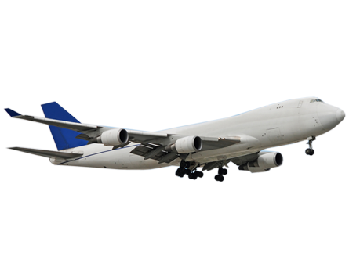
Average Arrival Delay per Flight
Does the number of incoming arrivals at a given airport impact the average arrival delay per flight?

Slide 33
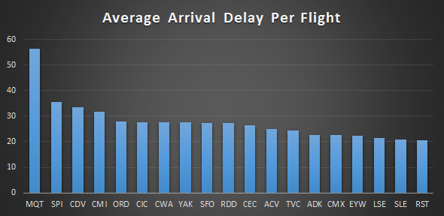
Top 20 Airports
Minutes

Slide 34
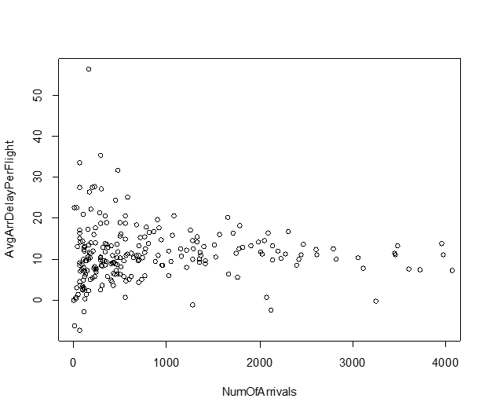
Number of Arrivals Vs. Average Arrival Delay per Flight
Residuals:
Min 1Q Median 3Q Max
-18.303 -3.351 -0.828 2.307 45.308
Coefficients:
Estimate Std. Error t value Pr(>|t|)
(Intercept) 1.103e+01 4.342e-01 25.411 <2e-16 ***
NumOfArrivals -1.086e-05 5.398e-05 -0.201 0.841
Signif. codes: 0 ‘***’ 0.001 ‘**’ 0.01 ‘*’ 0.05 ‘.’ 0.1 ‘ ’ 1
Residual standard error: 6.63 on 285 degrees of freedom
Multiple R-squared: 0.0001421, Adjusted R-squared: -0.003366
F-statistic: 0.04049 on 1 and 285 DF, p-value: 0.8407

Slide 35
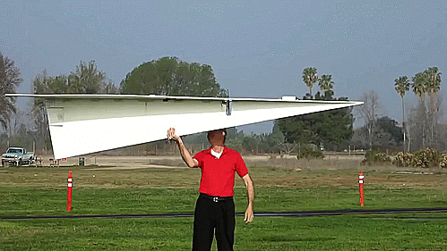

CONCLUSIONS / DISCUSSION
Implications / Conclusions
Delays will happen on average 20%.
The most occurrences of delays mainly come from late aircrafts, however, the longest delays are caused by weather.
Although the percentage of delays has remained relatively constant over time, the average length of delay has increased over time from 51 minutes in 2003 to 58 minutes in 2016. Airlines have not made progress in managing length of delay.
Limitations
Software limits the amount of data that can be analyzed effectively.
Did not have access to expensive enterprise softwares.
Some of the data did not lend itself to formal analysis.
Did not have powerful workstations to analyze the data of this magnitude. (7 million records)

Slide 36

